Slide 1
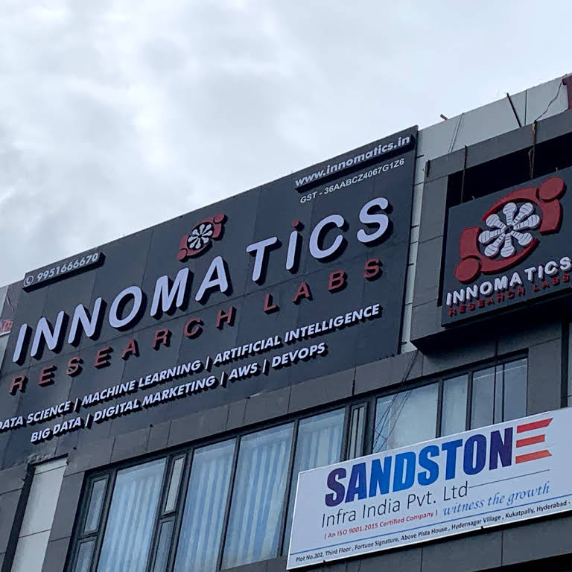
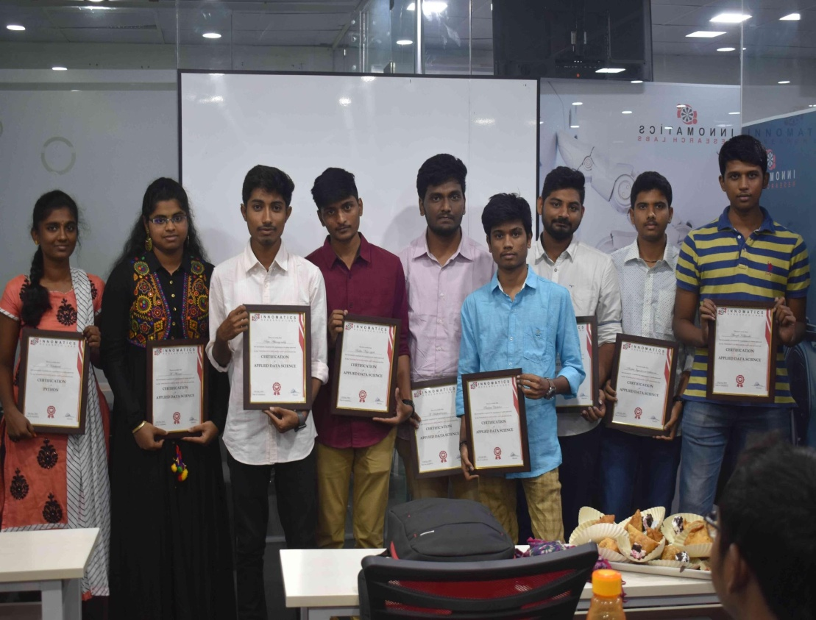
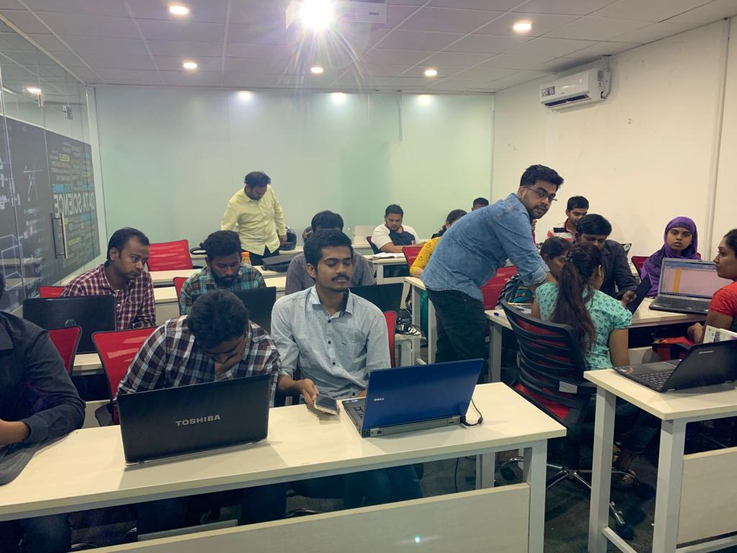

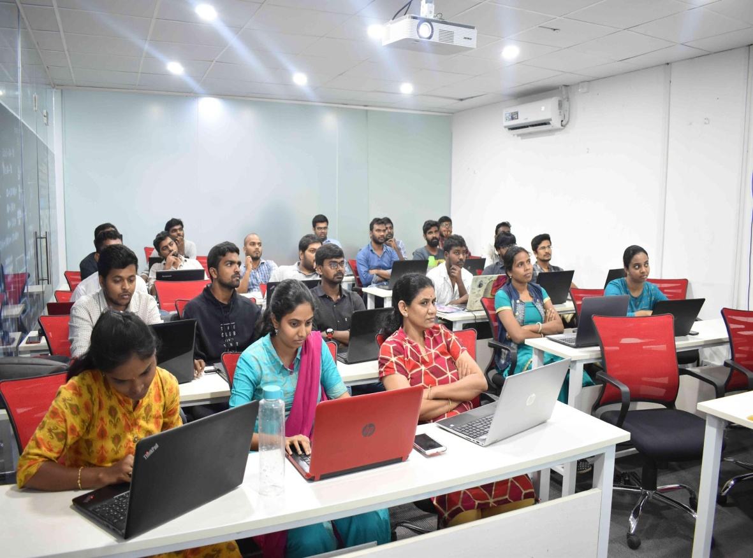
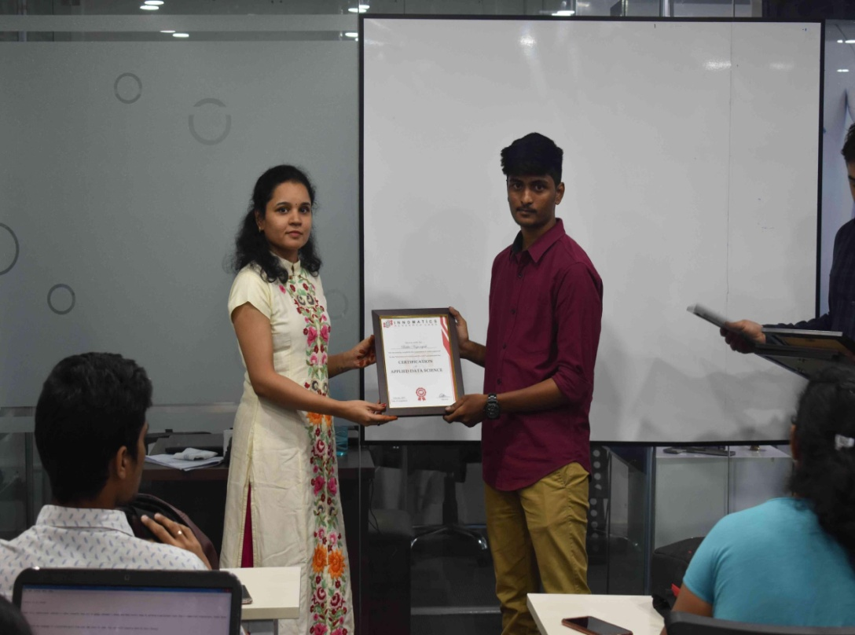
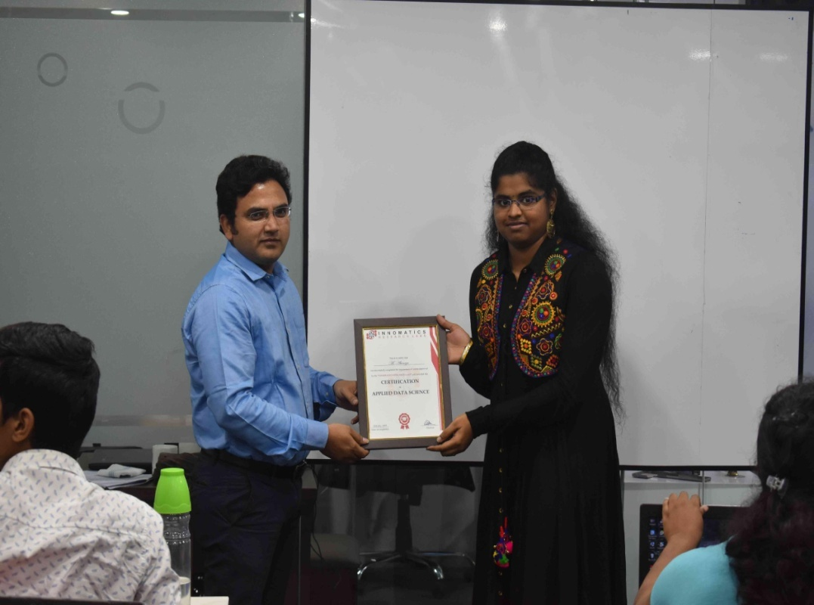

Slide 2
Music Recommender System

Slide 3
About Team
Background (B-tech or M-tech)
Team Members:
P Charith (B.Tech)
G M Nithin Sai (B.Tech)
Vidya Sagar Kunde (B.Tech)
Why do we want to learn Data Science
We want to learn Data Science because its interesting and trending.
Data science has a huge impact on various sectors of development.
Any work experience
P.Charith (No work experience)
G M Nithin Sai (No work experience)
Vidya sagar Kunde(No work experience)
What do we like about Innomatics Research lab
Innomatics Research lab is very well established and is very interactive .
The mentors, here, are very supportive and encouraging . The knowledge gained here during this internship is vast and is helping us understand the need to evolve with good ideas shaping our future.
we, heartily thank Innomatics Research labs for providing us with this opportunity.
we thank the mentors for helping us all the time.

Slide 4
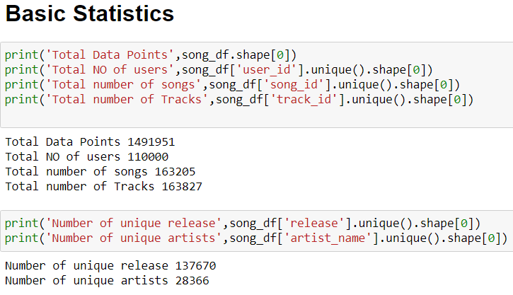
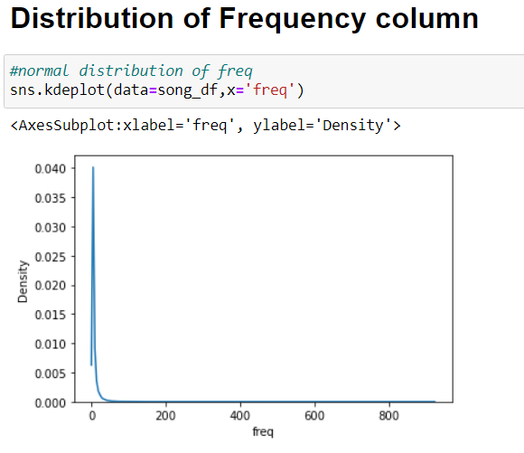
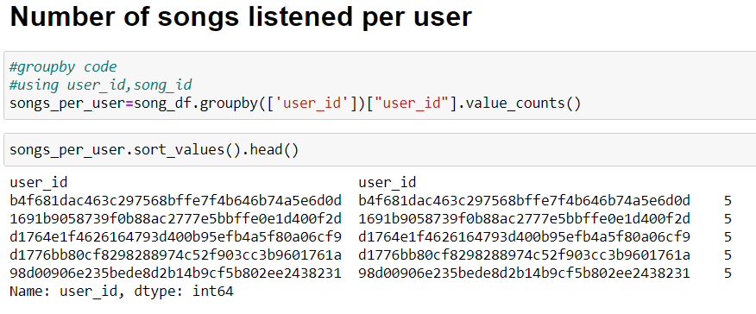
Explorative Data Analysis on the Dataset

Slide 5
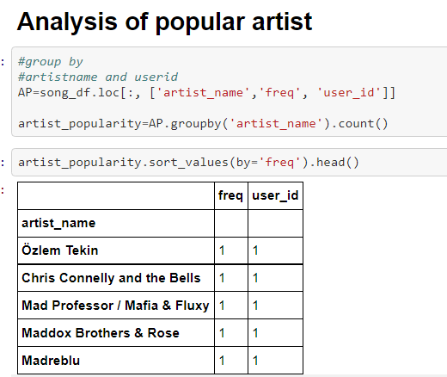
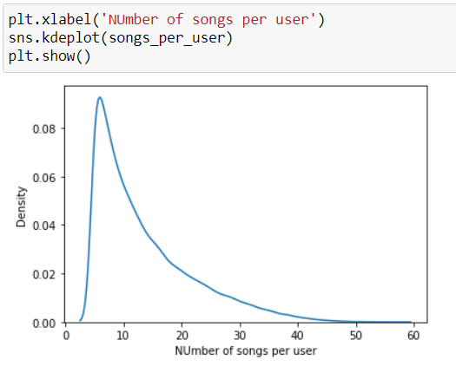
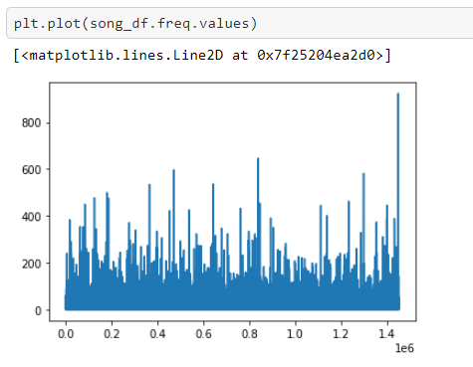
EDA (contind)

Slide 6
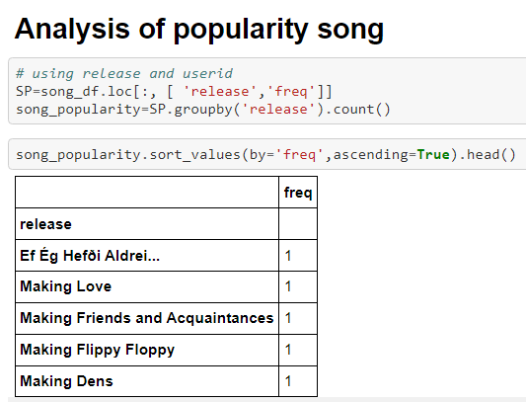
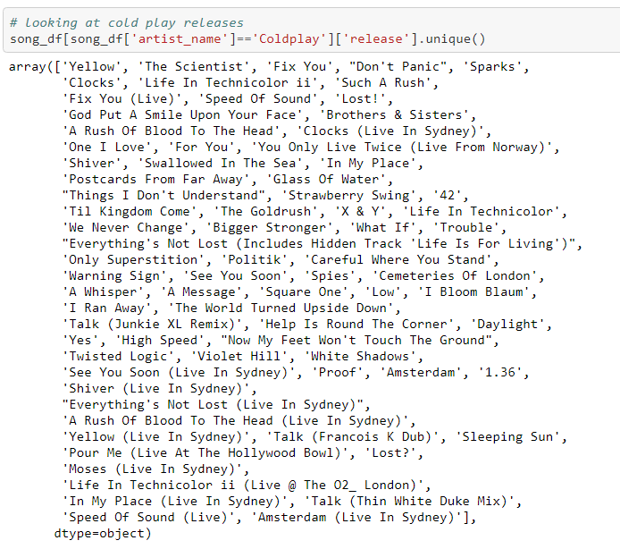
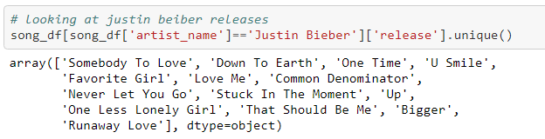

Slide 7
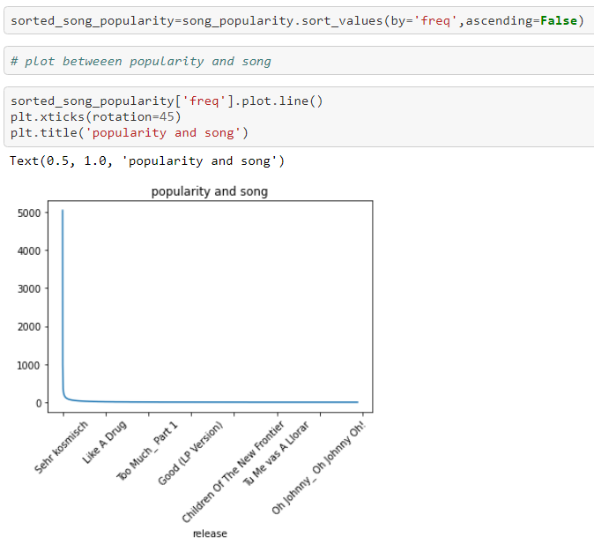
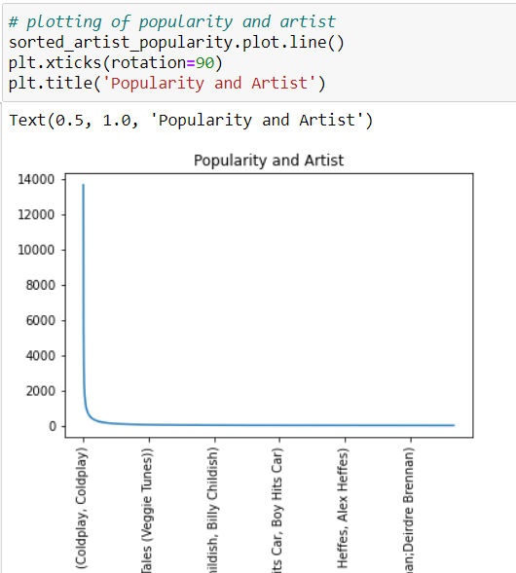

Slide 8
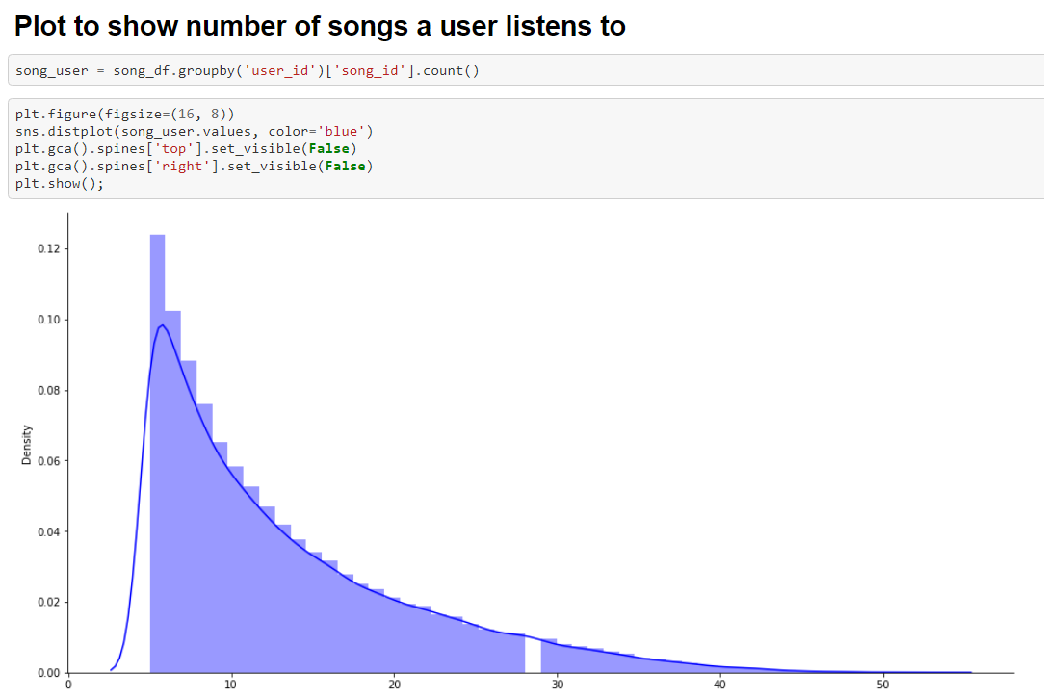
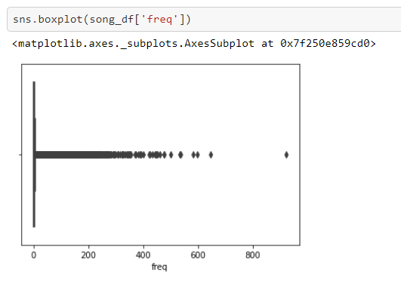
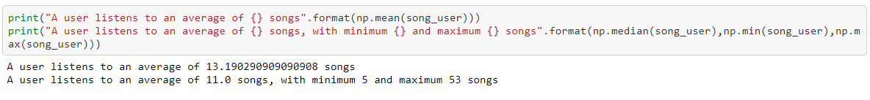
EDA (CONTND..)

Slide 9
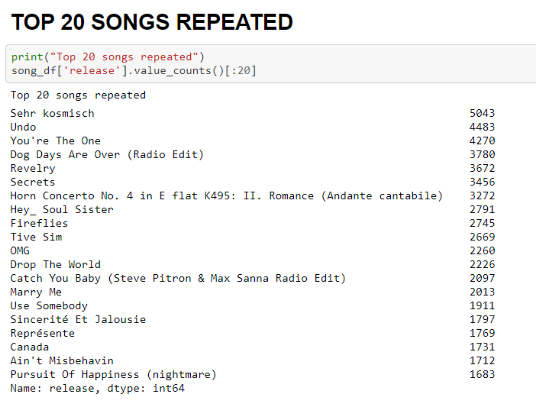
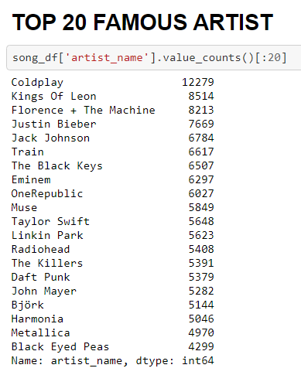
EDA (CONTD..)

Slide 10
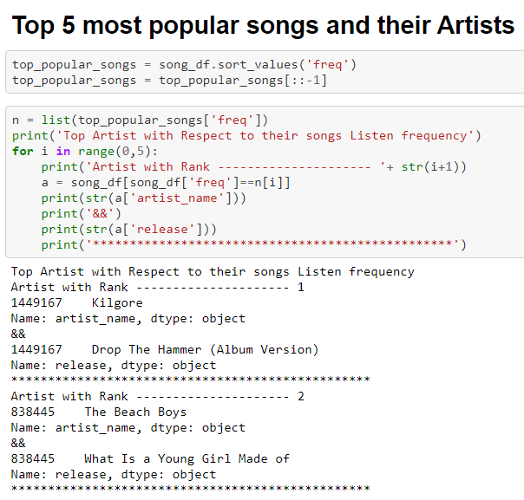

Slide 11
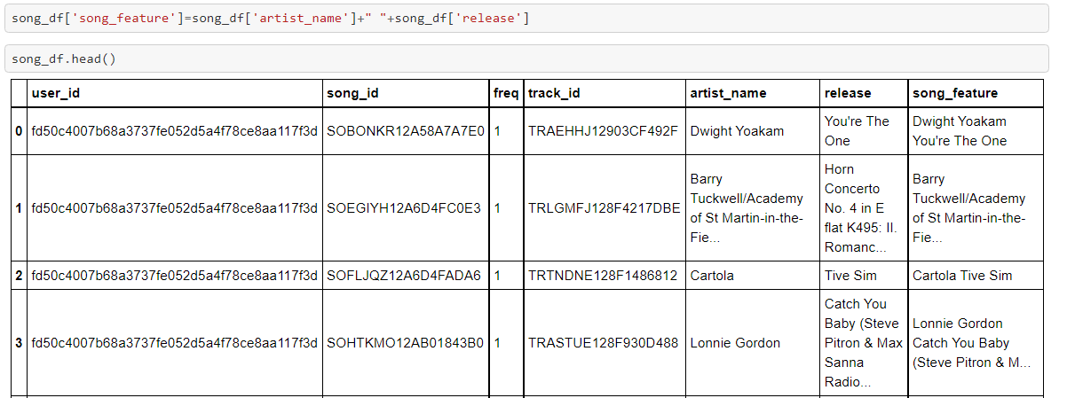
Data Preprocessing

Slide 12
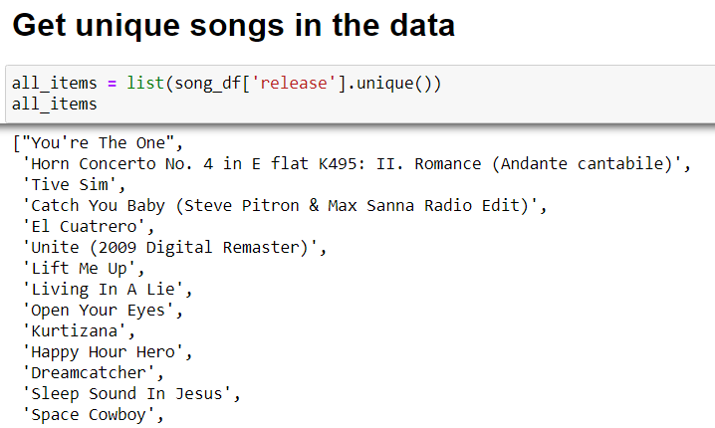
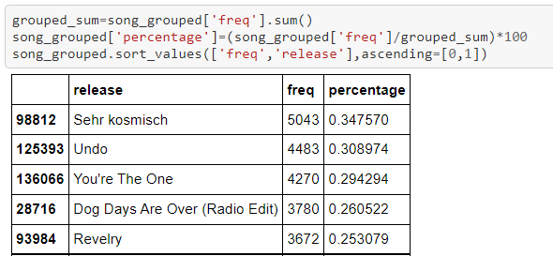
Data Preprocessing (contnd..)
Percentage of Frequency

Slide 13
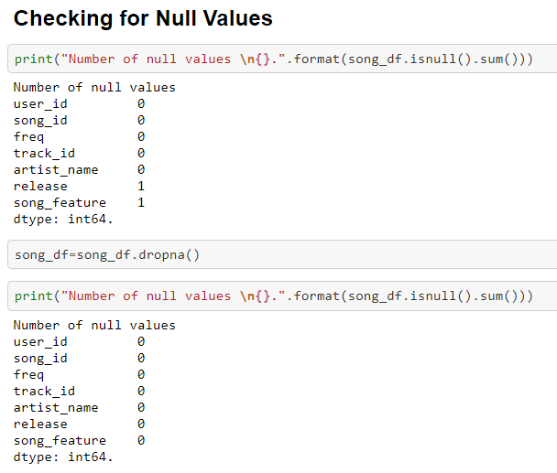

Slide 14
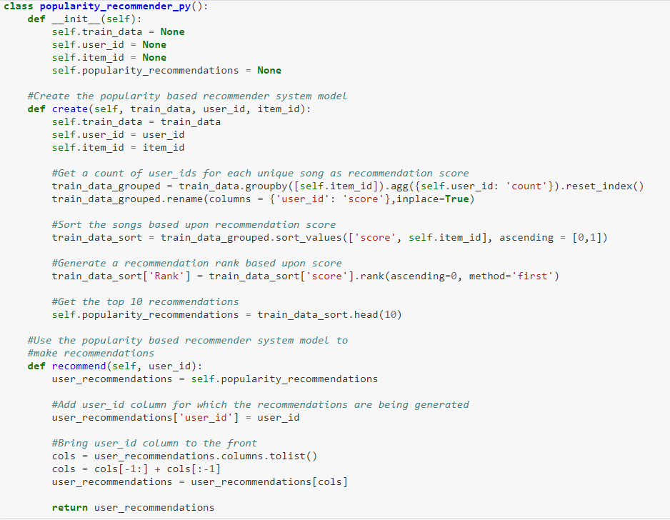
Popularity Based Recommender System

Slide 15
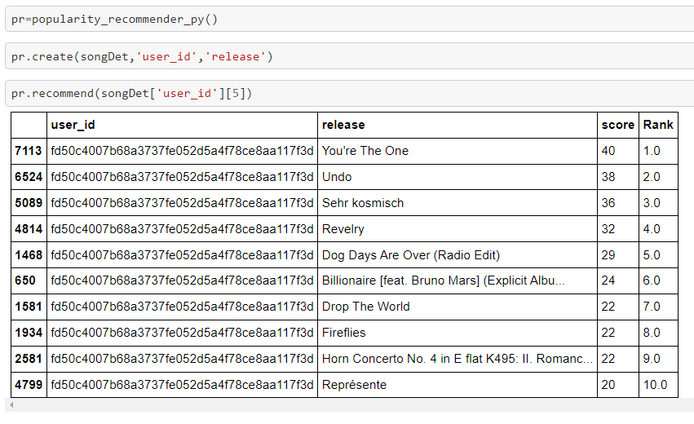
Popularity Based Recommendation (contnd..)
Hey Innominion, These are the most popular songs in trending right now, listen to it and follow the trend….☺ ☺☺
Innominion: I don’t follow the trend , I set the Trend ☺

Slide 16
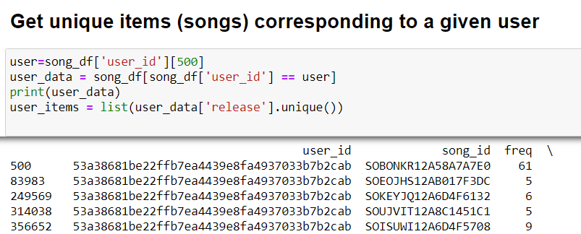
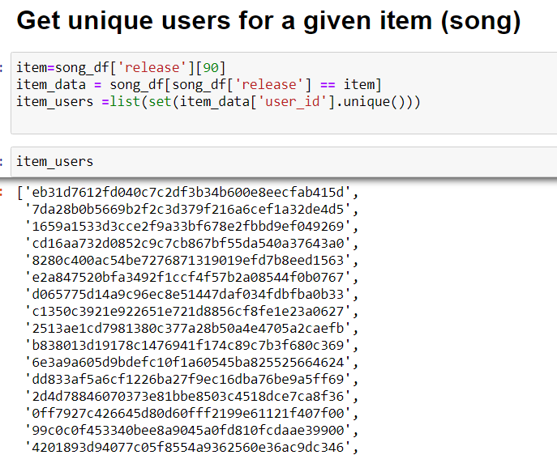
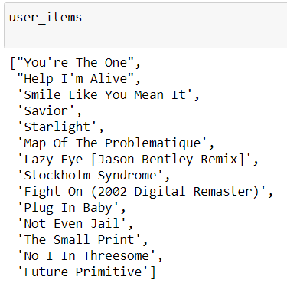
Item – Item Similarity Recommendation ( Collaborative Filtering)

Slide 17
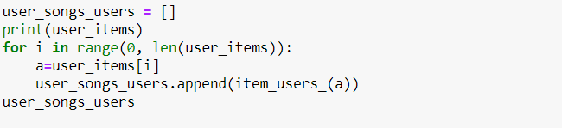
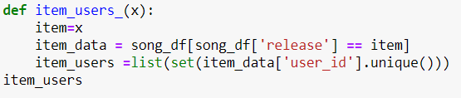
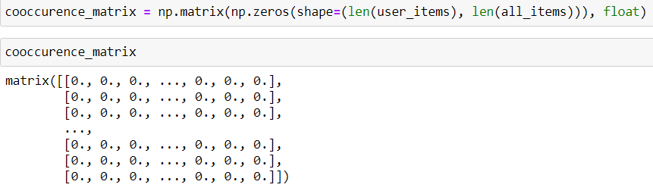
Item – Item Similarity Contnd..

Slide 18
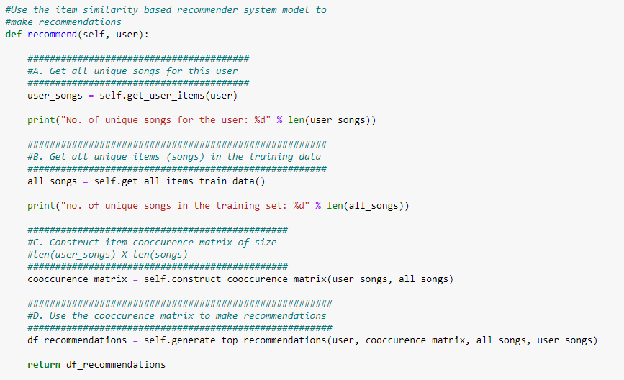
Item – Item Similarity Contnd..

Slide 19
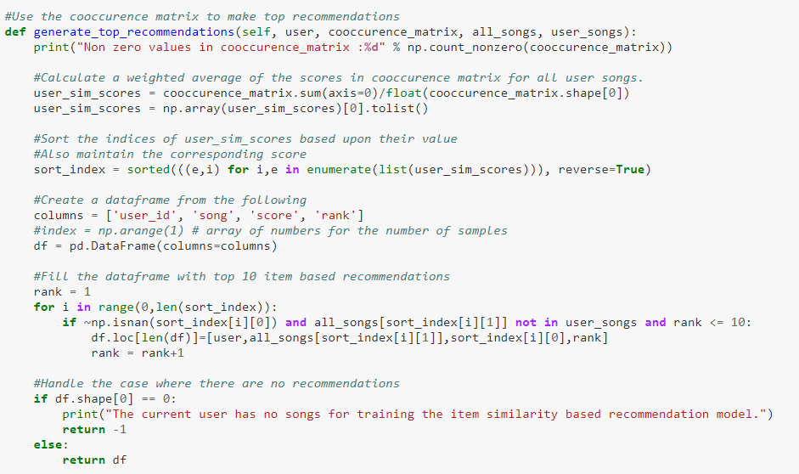
Item – Item Similarity Contnd..

Slide 20
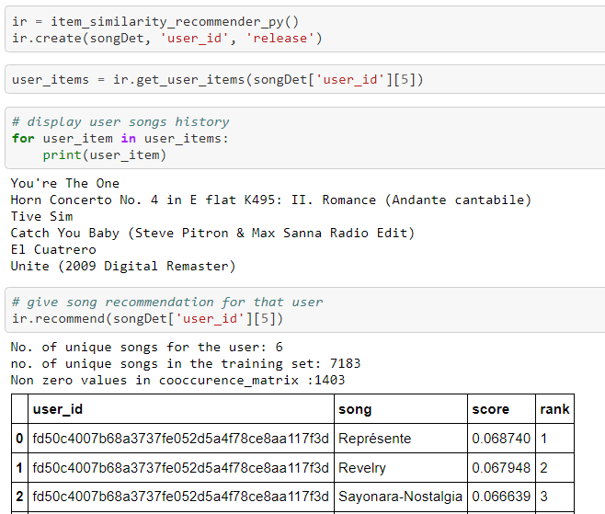
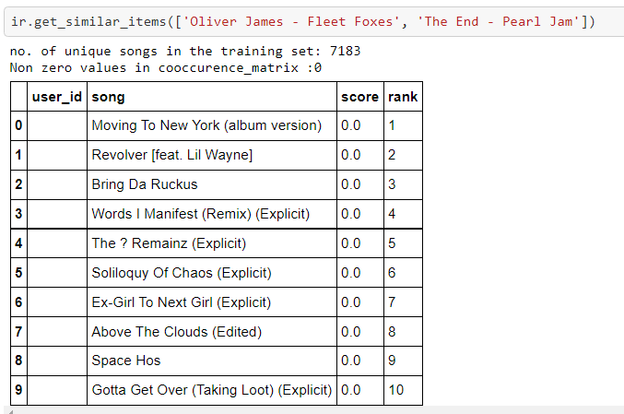

Slide 21
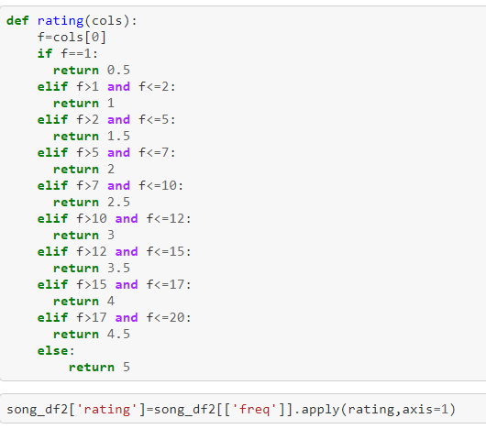
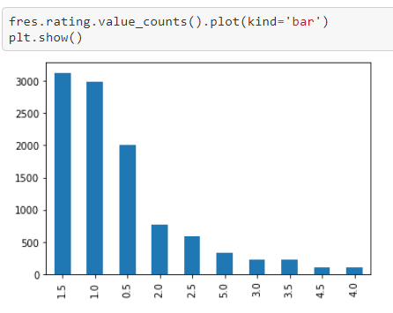
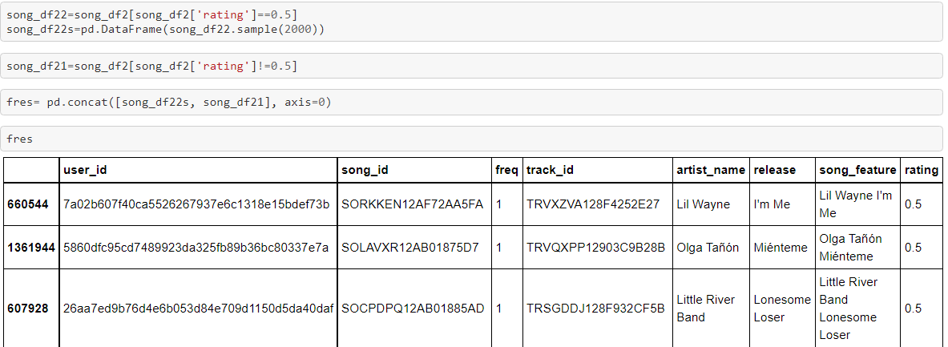
User Based Collaborative Filtering

Slide 22
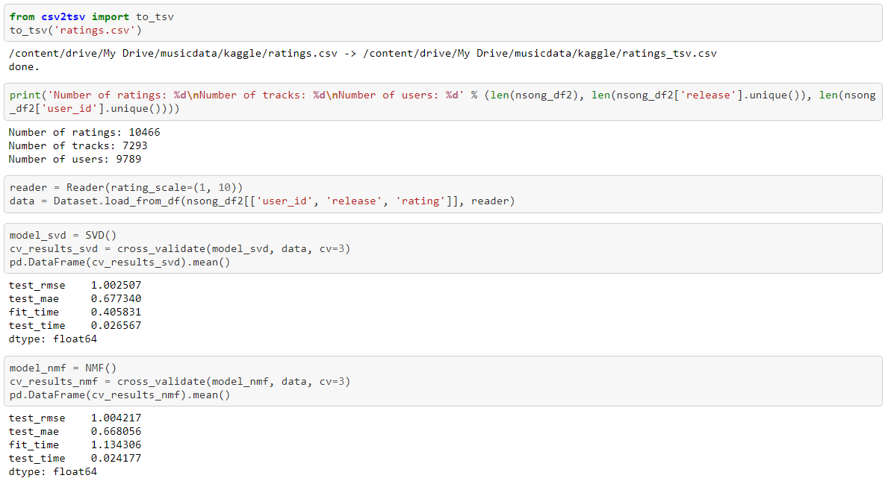

Slide 23
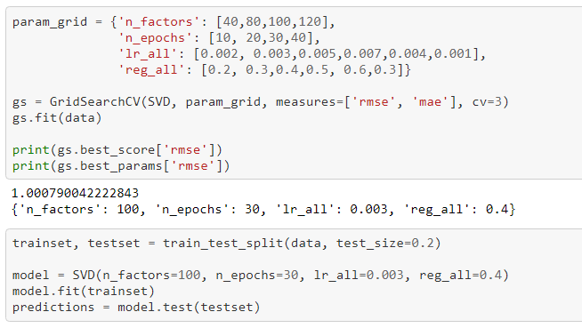
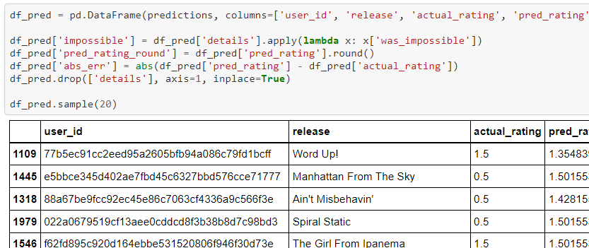
User Based Contnd..

Slide 24
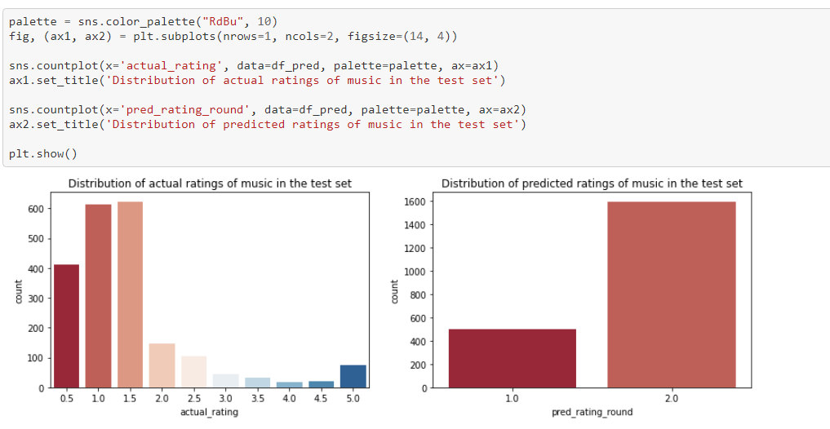
User Based contnd…

Slide 25
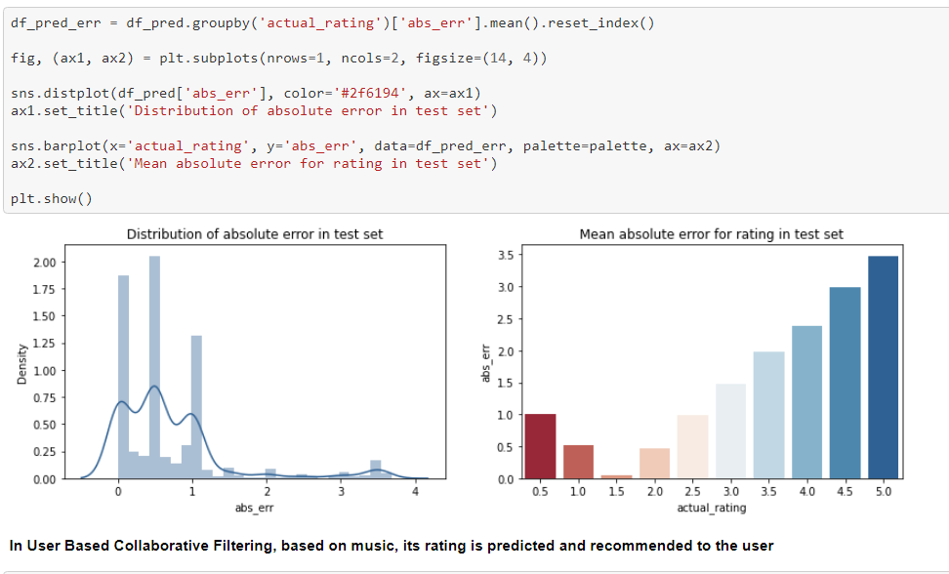
User Based contnd…

Slide 26
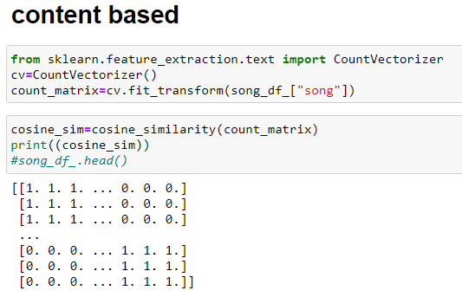
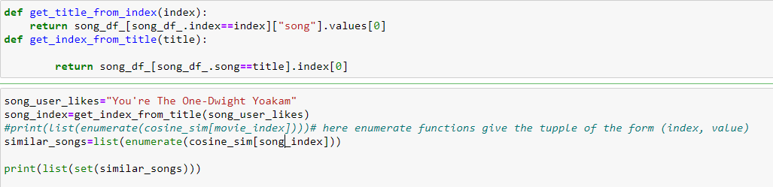
Content Based Filtering

Slide 27
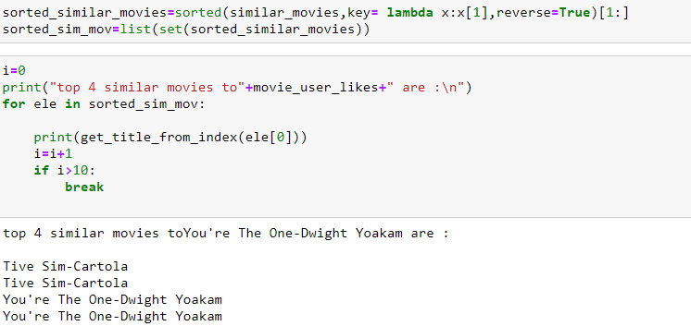

Contend Based Filtering (contnd..)

Slide 28

THANK YOU

